Slide 1
My vacation
Mrs. Rattanaporn Lawsawas
Ban Huaybong School, Nakhonsawan

Slide 2
beach

Slide 3
forest

Slide 4
mountain

Slide 5
city

Slide 6
countryside

Slide 7
waterfall

Slide 8
Review again

Slide 9
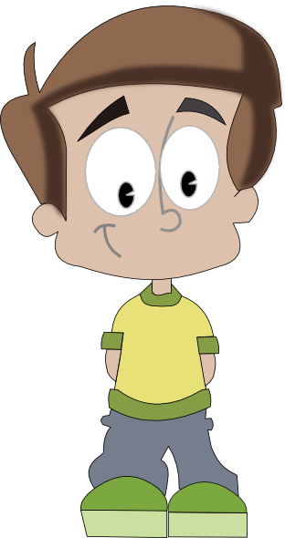
Hi.
My name is Peter

Slide 10
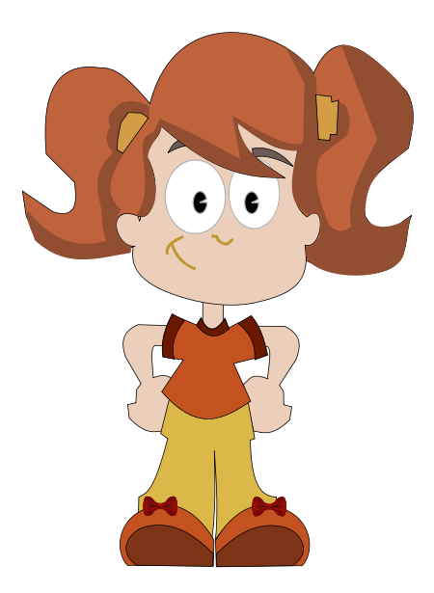
Hello.
My name is Nancy

Slide 11
Please tell me where they were on vacation.

Slide 12
การใช้ was กับ were
ปัจจุบัน ใช้ verb to be :
is ใช้กับประธานเอกพจน์ (1 คน)
He, She, It
am ใช้กับประธาน I
are ใช้กับประธานพหูพจน์ (หลายคน)
You, We, They
was
were
อดีต

Slide 13
Where was Peter?
He was at the beach.

Slide 14
Was he at the beach?
Yes, he was.

Slide 15
Was it good?
Yes, it was.

Slide 16
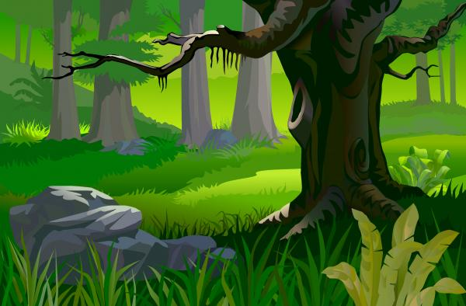
Where was Peter?
He was in the forest.

Slide 17
Was he in the forest?
Yes, he was.

Slide 18
Was it good?
Yes, it was.

Slide 19
Where was Nancy?
She was in the city.

Slide 20
Was she in the forest?
No, she was not.

Slide 21
Was it good?
No, it was not.

Slide 22
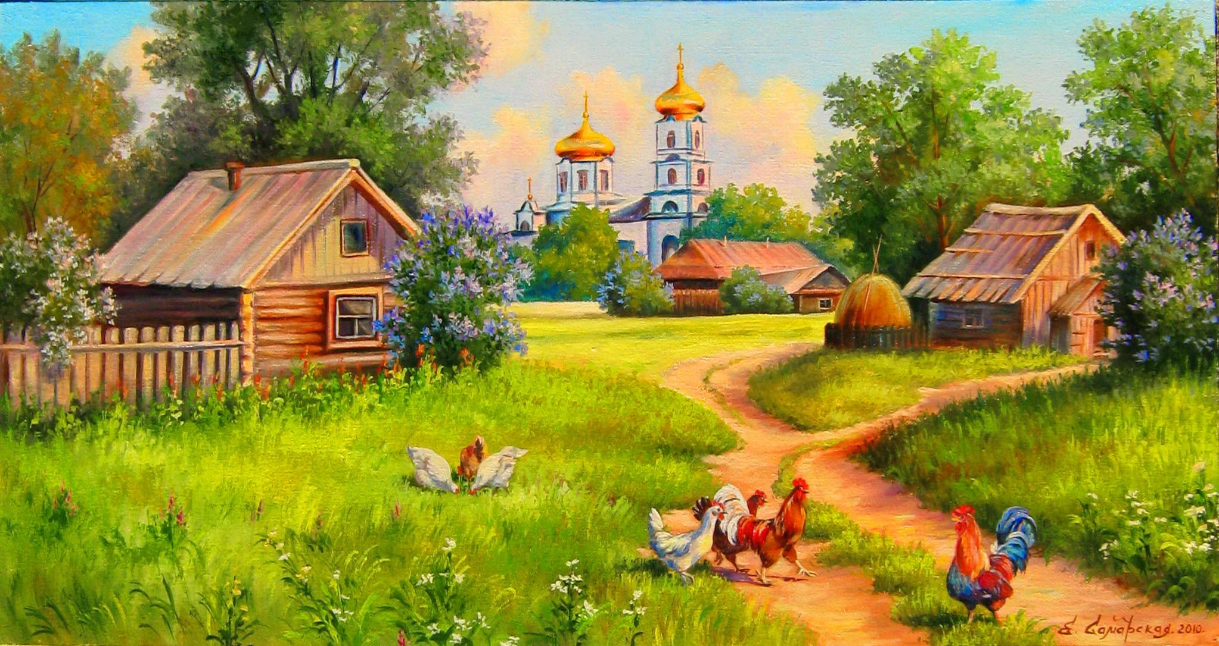
Where was Nancy?
She was in the countryside.

Slide 23
Was she in the city?
No, she was not.

Slide 24
Was it good?
Yes, it was.

Slide 25
Your turn
One by one

Slide 26
Where was Peter?
He was at the waterfall.

Slide 27
Was he at the waterfall?
Yes, he was.

Slide 28
Was it good?
Yes, it was.

Slide 29
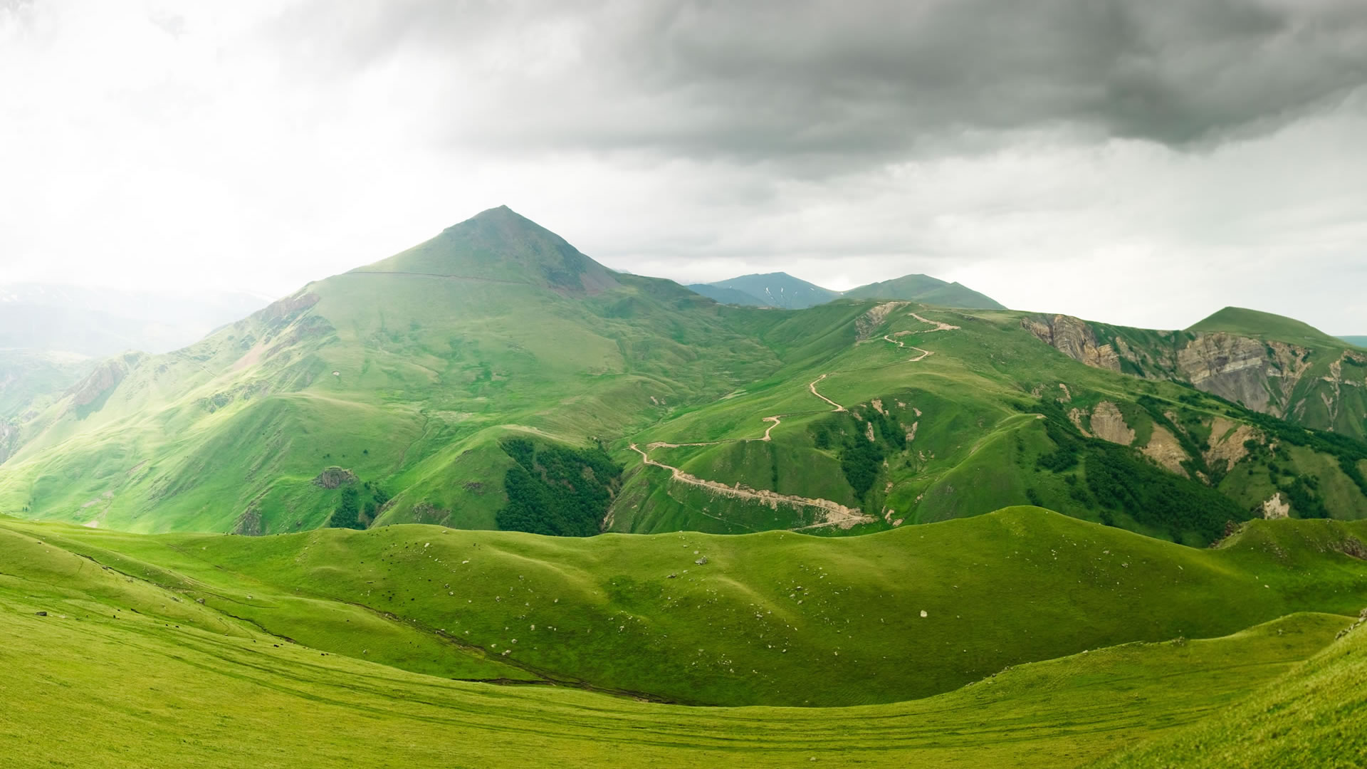
Where was Nancy?
She was in the mountains.

Slide 30
Was she at the beach?
No, she was not.

Slide 31
Was it good?
No, it was not.

Slide 32
Let’s talk.
Use these questions to ask your friend.

Slide 33
ตัวอย่าง
A : Where were you on vacation?
B : I was at the beach.
A : Was it good?
B : Yes, it was.
หรือ No, it was not.

Slide 34
วาดรูประบายสี พร้อมเขียนบรรยาย
I was in/on/at the _________.
It was / wasn’t good.

