Slide 2
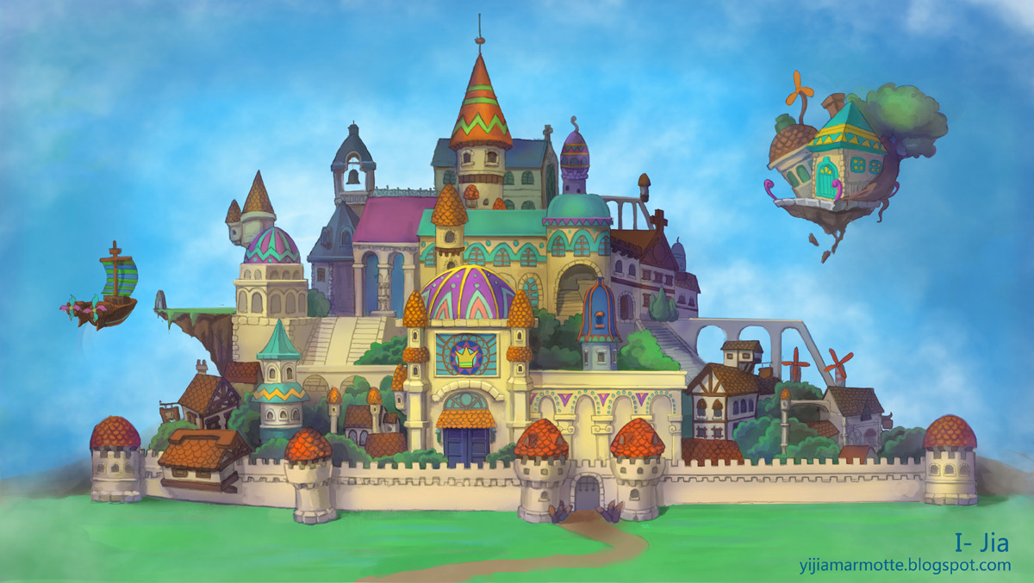

Slide 3
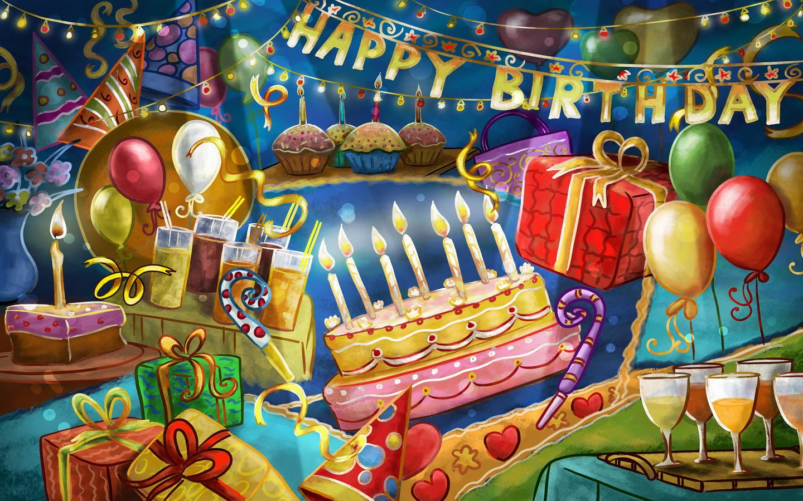

Slide 4
“Heart Stickers” You are good at English! For you in Grade 5/2 Nov. 27, 2015

Slide 5
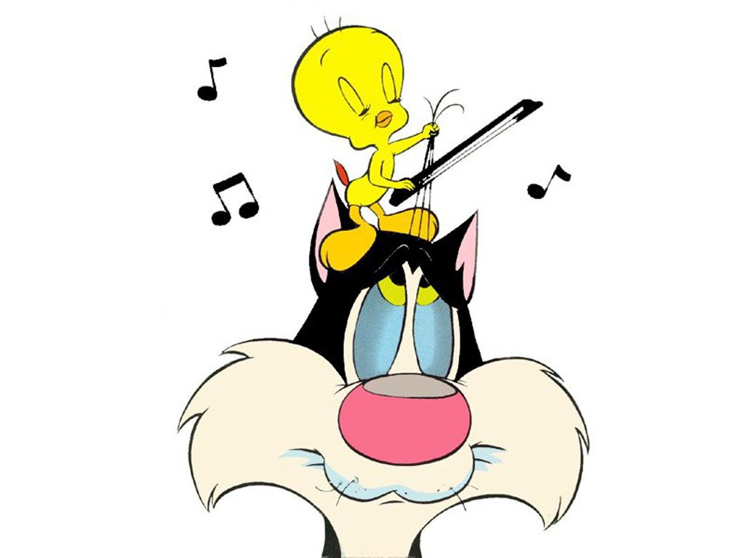
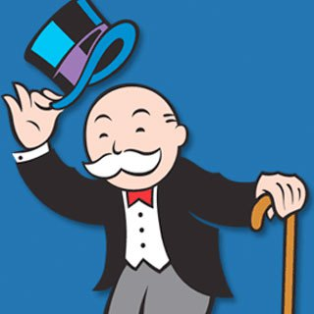

Slide 6
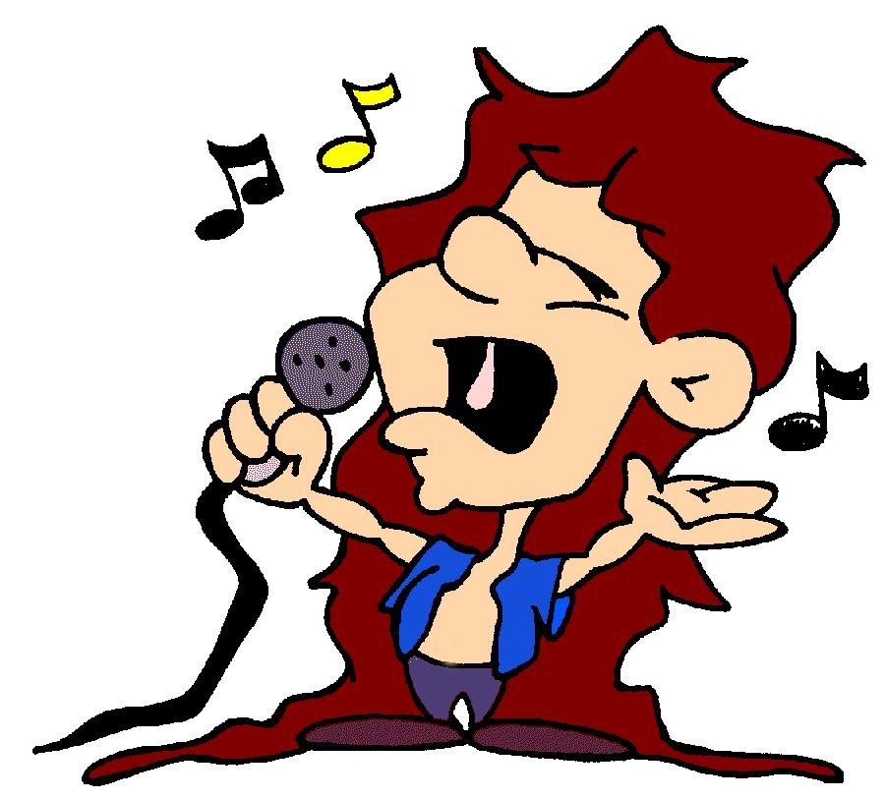

Slide 8
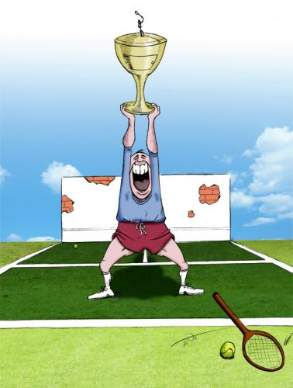
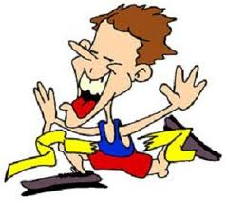

Slide 9
“Heart Stickers” You are good at English! For you in Grade 5/2 Nov. 27, 2015

Slide 10
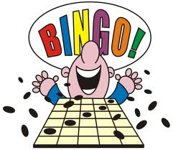
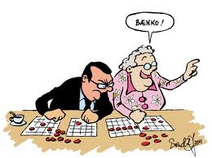

Slide 11
Bingo Words
1.fly flew 2.do, does did
3.sit sat 4.be was, were
5.put put 6.cut cut
7.sing sang 8.hit hit
9.let let 10.pay paid
11.ring rang 12.go went
13.run ran 14.buy bought
15.keep kept 16.bring brought
17.read read 18.get got
19.sell sold 20.take took

Slide 12
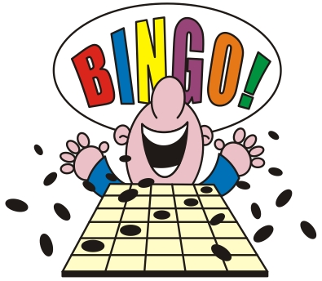

Slide 13
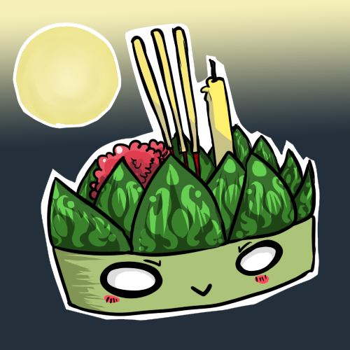
Pre-test (Irregular Verbs)
November full moon shines
1.Begin ……………. …………… Loy Krathong, Loy Krathong
2.Drink …………….. ………….
3.Read …………. …………….
and the water’s high
4.Eat ………. ………………..
5.Ride ………………. ……………..
in the local river and the Klong Loy Loy Krathong,
Loy Loy Krathong Loy Krathong is here
Loy Krathong 6.Buy ………… ……………

Slide 14
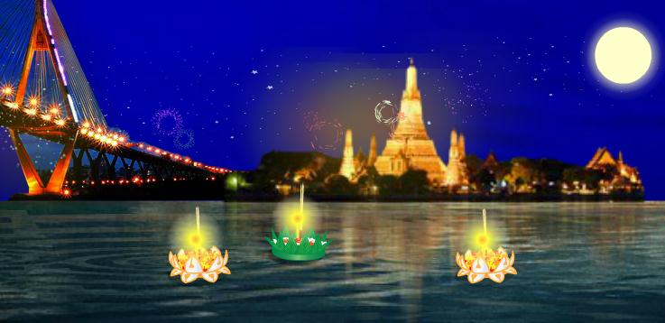
Pre-test (Irregular Verbs)
and everybody’s full of cheer
7.Cut …….. ……… 8.Hit ……… ………
9.Cost ………. ………… 10.Bring ………. ………….
We’re together at the Klong
11.Swear ………. ………………….. Each one with his Krathong
12.Do does …….. …………….. As we push away we pray
13.Is am are …….. , ……. ……………. We can see a better day.
We can see three verbs again.

Slide 15
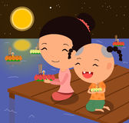
The correct answers
1.Begin began begun
Loy Krathong, Loy Krathong 2.Drink drank drunk
3.Read read read
4.Eat ate eaten
5.Ride rode ridden
Loy Loy Krathong,
Loy Loy Krathong
Loy Krathong 6.Buy bought bought

Slide 16
The correct answers
7.Cut cut cut
8.Hit hit hit
9.Cost cost cost
10.Bring brought brought
11.Swear swore sworn 12.Do does did done 13.Is am are… was , were been We can see three verbs again.

Slide 17
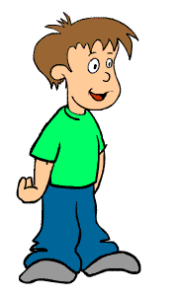
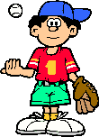
Loy and Krathong

Slide 18
One day on the full moon night in November, there were two good boys in the village, their names were Loy and Krathong.

Slide 19
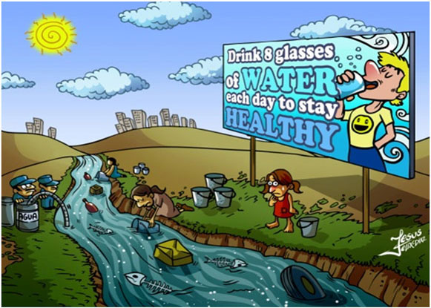
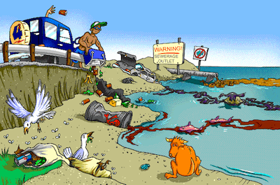
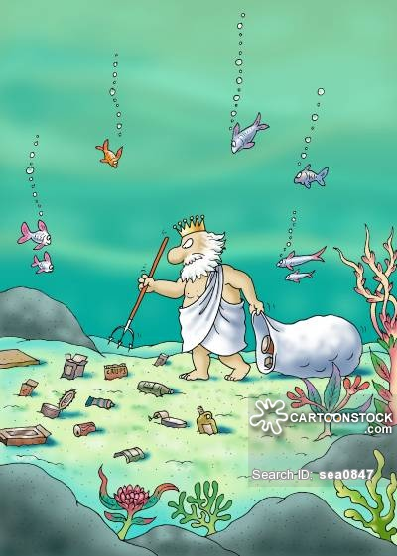
They liked to help the other people. They were poor but happy. They wanted
to tell the people for
cleaning the river.

Slide 20
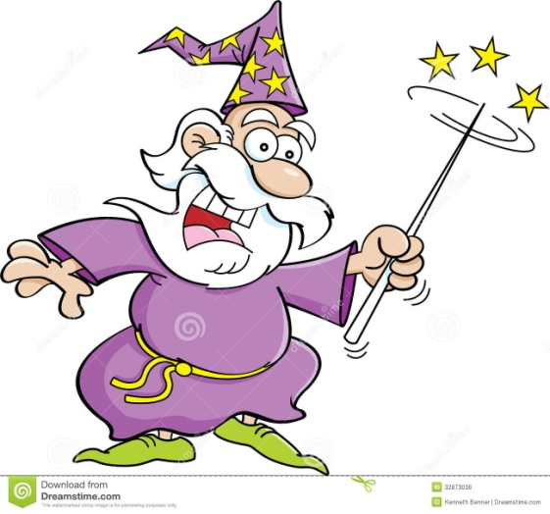
So they told everyone that there was a magic man who told them about there was a lot of money for a man who could collect the most garbage from
the river.

Slide 21
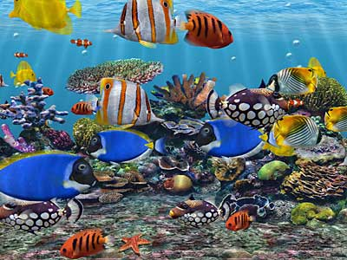
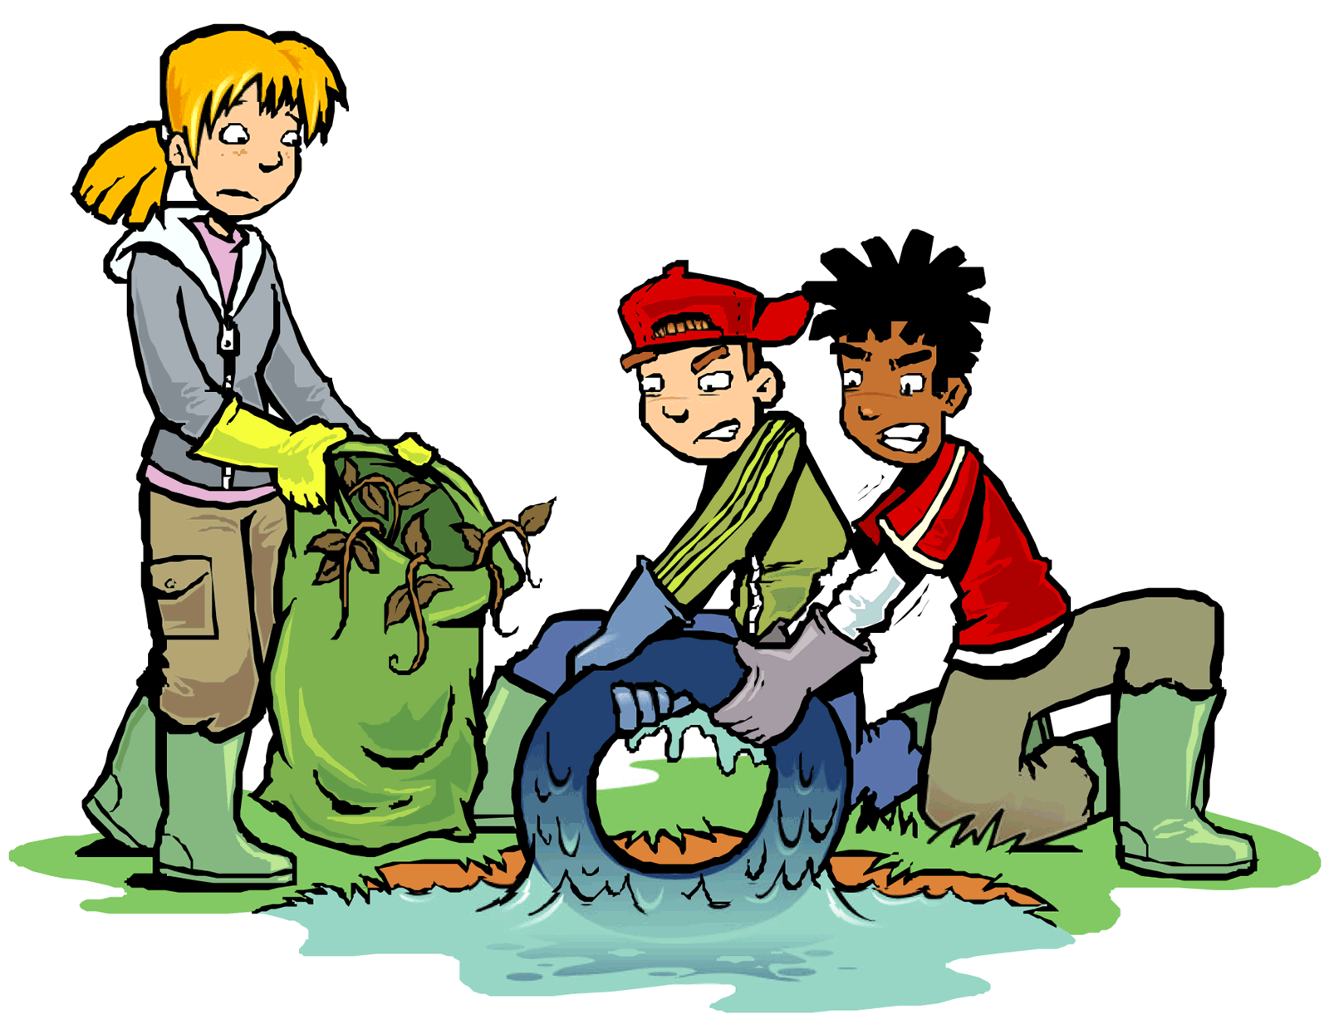
Many people went to the river and helped to collect it. After that the river was very clean and there were
a lot of fish
in it.

Slide 22
The people caught a lot of fish and they were richer. Loy and Krathong told them the truth that there was not
a magic man and
no money
from him.

Slide 23
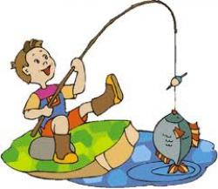
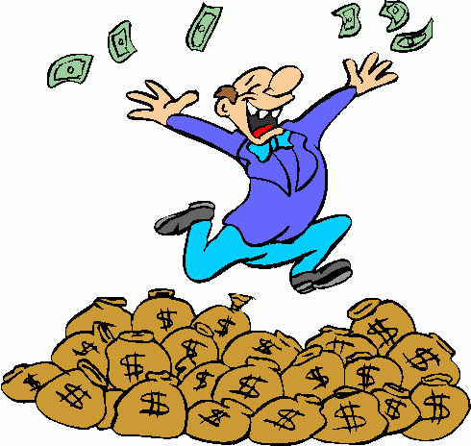
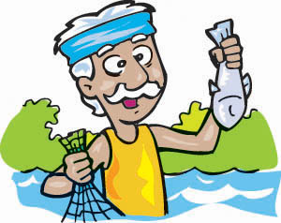
But they could be richer from catching the fish if the river was clean.

Slide 24
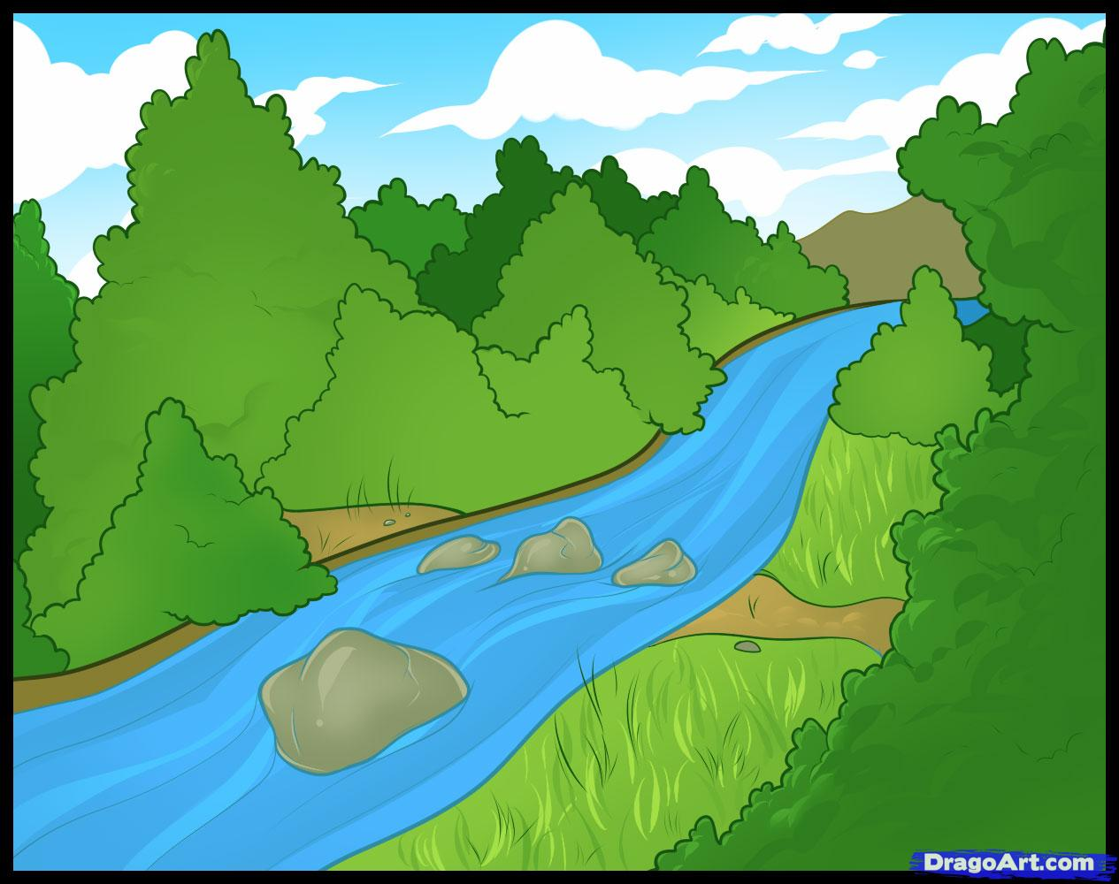
The End

Slide 25
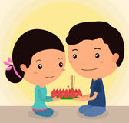
Irregular Verbs
1.Begin began begun
2.Drink drank drunk
3.Read read read
4.Eat ate eaten
5.Ride rode ridden
6.Buy bought bought

Slide 26
Irregular Verbs
7.Cut cut cut
8.Hit hit hit
9.Cost cost cost
10.Bring brought brought
11.Swear swore sworn
12.Do does did done
13.Is am are… was were been

Slide 27
Loy Krathong Irregular Verbs
November full moon shines
Begin began begun Loy Krathong, Loy Krathong
and the water’s high
Drink drank drunk read read
in local river and the Klong
Eat ate eaten ride rode ridden Loy Loy Krathong,
Loy Loy Krathong Loy Krathong is here
Loy Krathong buy bought

Slide 28
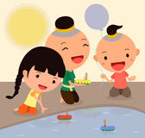
Loy Krathong Irregular Verbs
and everybody’s full of cheer
Cut cut hit hit cost cost bring brought
We’re together at the Klong
Swear swore sworn Each one with his Krathong
Do does did done As we push away we pray
Is am are was were been We can see a better day.
We can see three verbs again.

Slide 29
Post-test (Irregular Verbs)
November full moon shines
1.Begin ……………. …………… Loy Krathong, Loy Krathong
2.Drink …………….. ………….
3.Read …………. …………….
and the water’s high
4.Eat ………. ………………..
5.Ride ………………. ……………..
in the local river and the Klong Loy Loy Krathong,
Loy Loy Krathong Loy Krathong is here
Loy Krathong 6.Buy ………… ……………

Slide 30
Post-test (Irregular Verbs)
and everybody’s full of cheer
7.Cut …….. ……… 8.Hit ……… ………
9.Cost ………. ………… 10.Bring ………. ………….
We’re together at the Klong
11.Swear ………. ………………….. Each one with his Krathong
12.Do does …….. …………….. As we push away we pray
13.Is am are …….. , ……. ……………. We can see a better day.
We can see three verbs again.

Slide 31
Irregular Verbs
1.Begin began begun
2.Drink drank drunk
3.Read read read
4.Eat ate eaten
5.Ride rode ridden
6.Buy bought bought

Slide 32
Irregular Verbs
7.Cut cut cut
8.Hit hit hit
9.Cost cost cost
10.Bring brought brought
11.Swear swore sworn
12.Do does did done
13.Is am are… was were been

Slide 33
And now this is your homework!

Slide 34
Copy Loy Krathong Irregular Verbs into your
paper.

Slide 35
Loy Krathong Irregular Verbs
November full moon shines
Begin began begun Loy Krathong, Loy Krathong
and the water’s high
Drink drank drunk read read
in local river and the Klong
Eat ate eaten ride rode ridden Loy Loy Krathong,
Loy Loy Krathong Loy Krathong is here
Loy Krathong buy bought

Slide 36
Loy Krathong Irregular Verbs
and everybody’s full of cheer
Cut cut hit hit cost cost bring brought
We’re together at the Klong
Swear swore sworn Each one with his Krathong
Do does did done As we push away we pray
Is am are was were been We can see the better day.
We can see three verbs again.

