Slide 1

Free time / Hobby

Slide 2
What do you do in your free time?

Slide 3
English Words for Hobbies

Slide 4

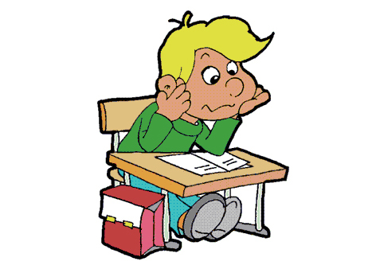

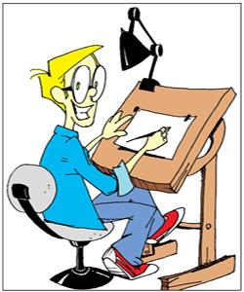

Hobbies you do in your free time…
listening to music
reading books
singing
drawing
painting

Slide 5
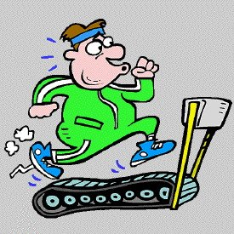
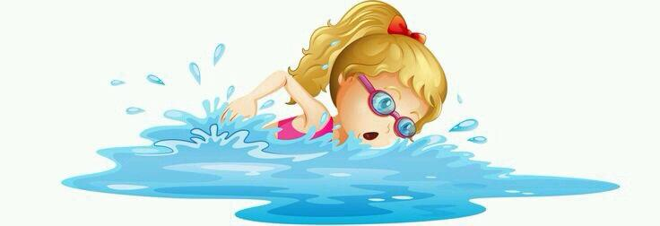
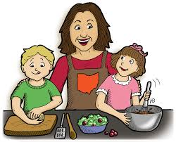
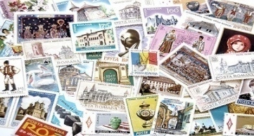

doing exercise
swimming
cooking
collecting stamps
riding a bike

Slide 6
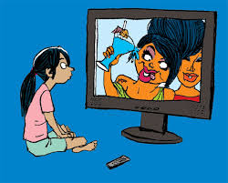

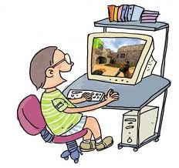
playing football
watching TV
fishing
playing a computer game

Slide 7
Let’s talk/converse

Slide 8
Q: What do you like to do in your free time?
A: I like watching TV.
Q: Do you like to watch TV?
A: Yes, I do. No, I don’t.

Slide 9
Q: Did you watch TV yesterday?
A: Yes, I did. No, I didn’t.
Q: What is your hobby?
A: Drawing is my hobby.

